Slide 1
Issues with Housing
V0.3 - Prototype

Slide 2
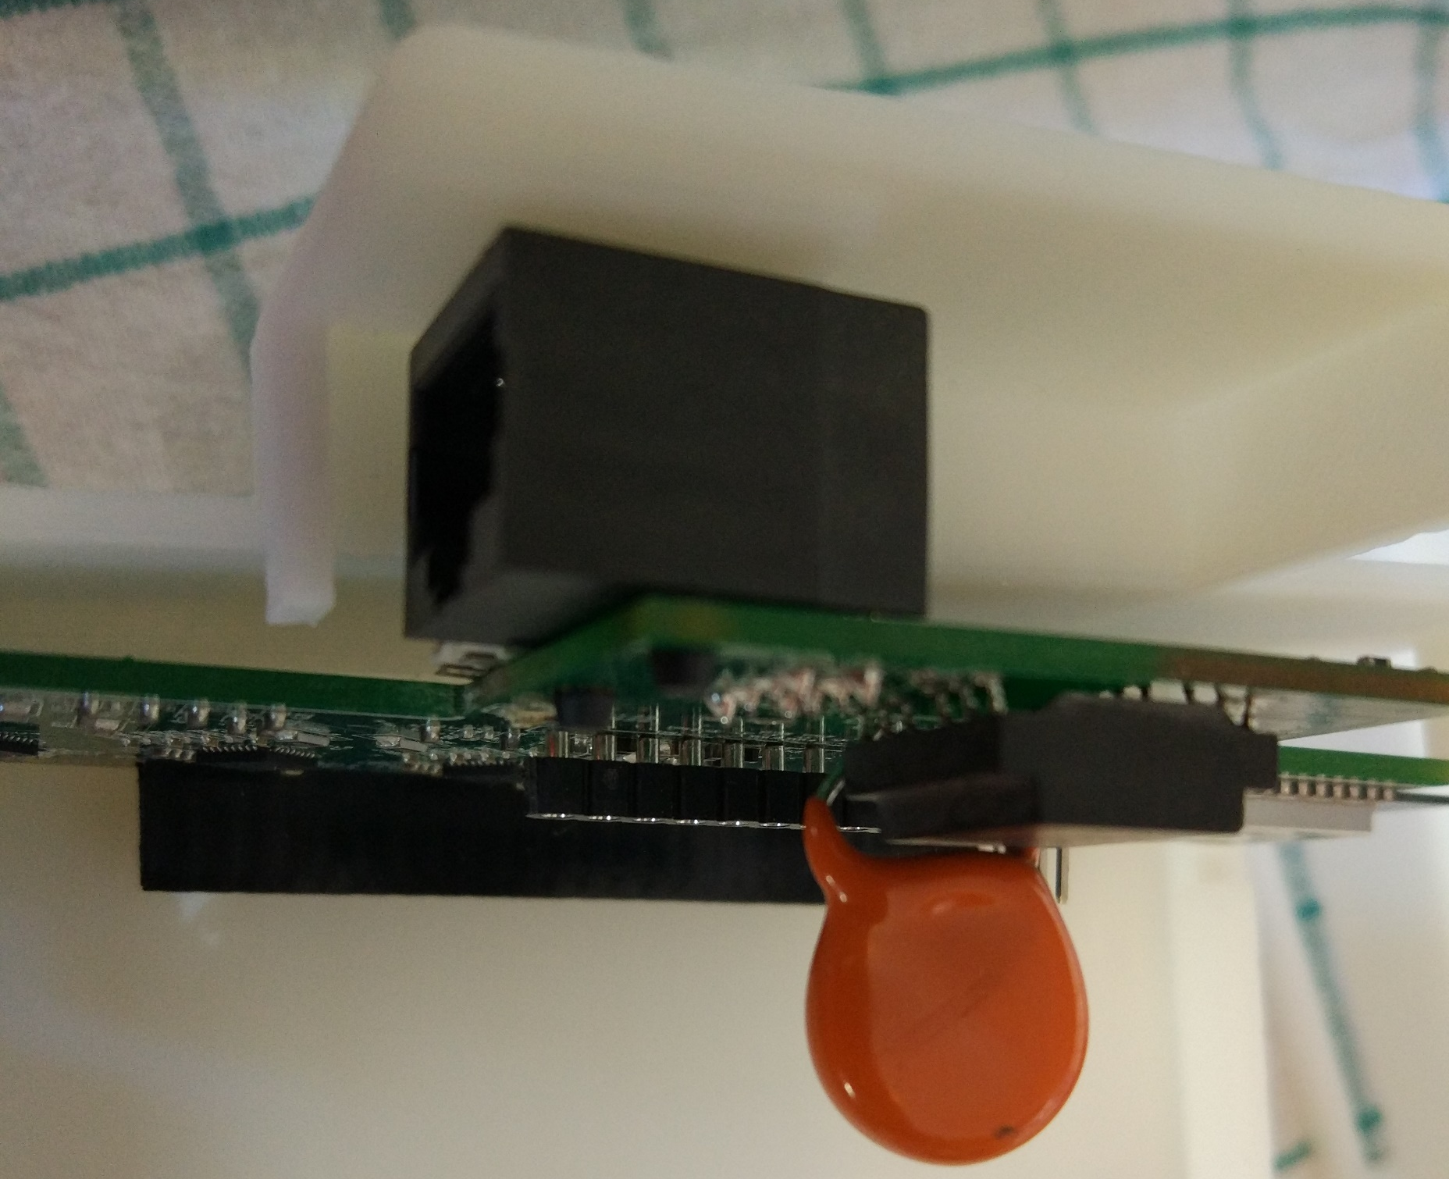
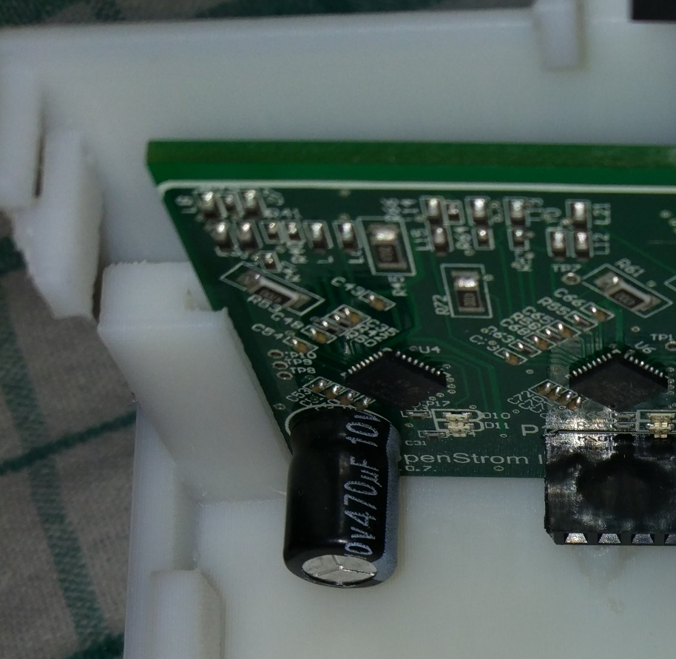
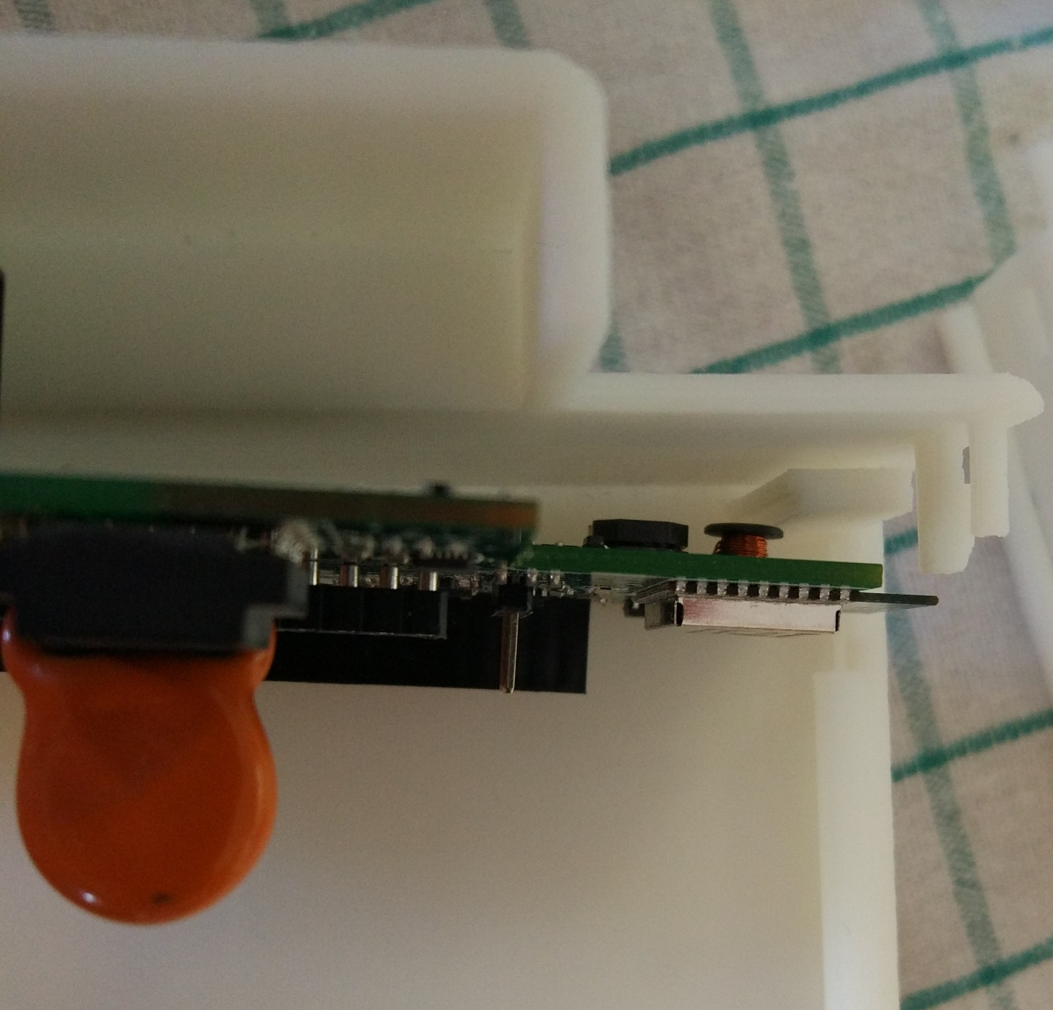
Controller board
Controller boar doesn’t fit. Ethernet port not at edge of housing

Slide 3
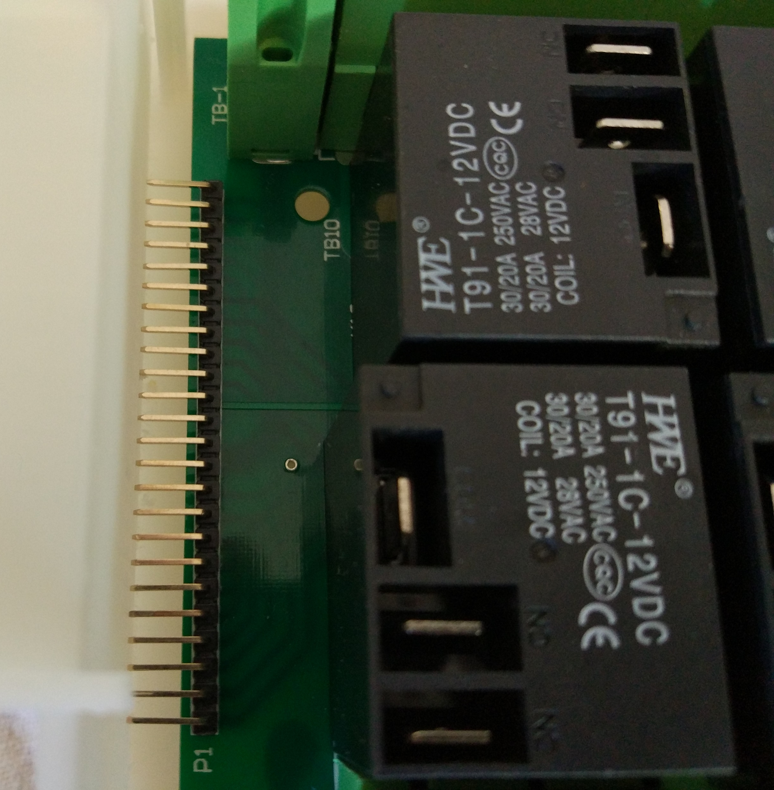
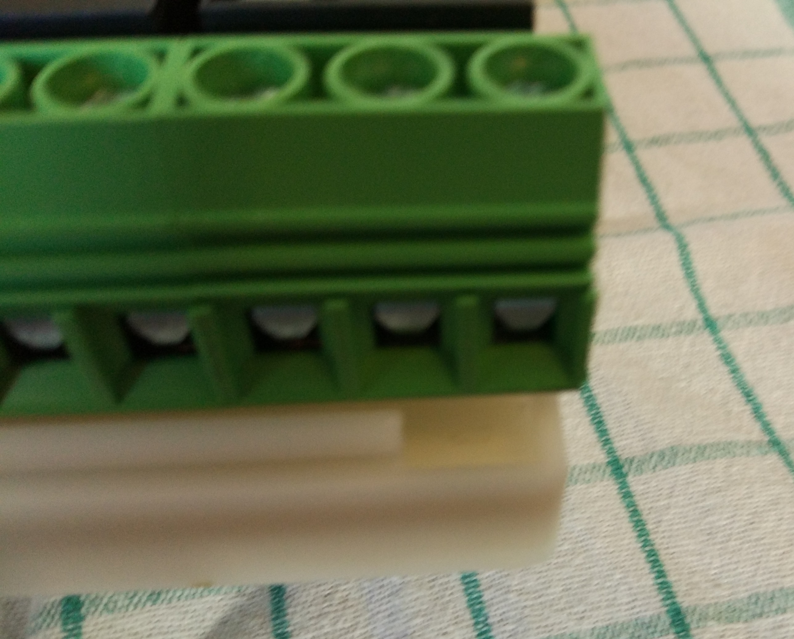
Relay Board
Board is longer than housing Mounting screws have no support in housing

Slide 4
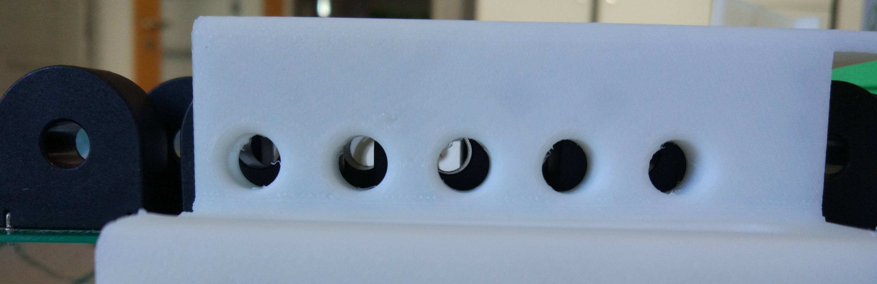
Transformer board
Holes do not align with transformers
Also board doesn’t fit into guide (board too thick, plus consider solder on underside)

Slide 5
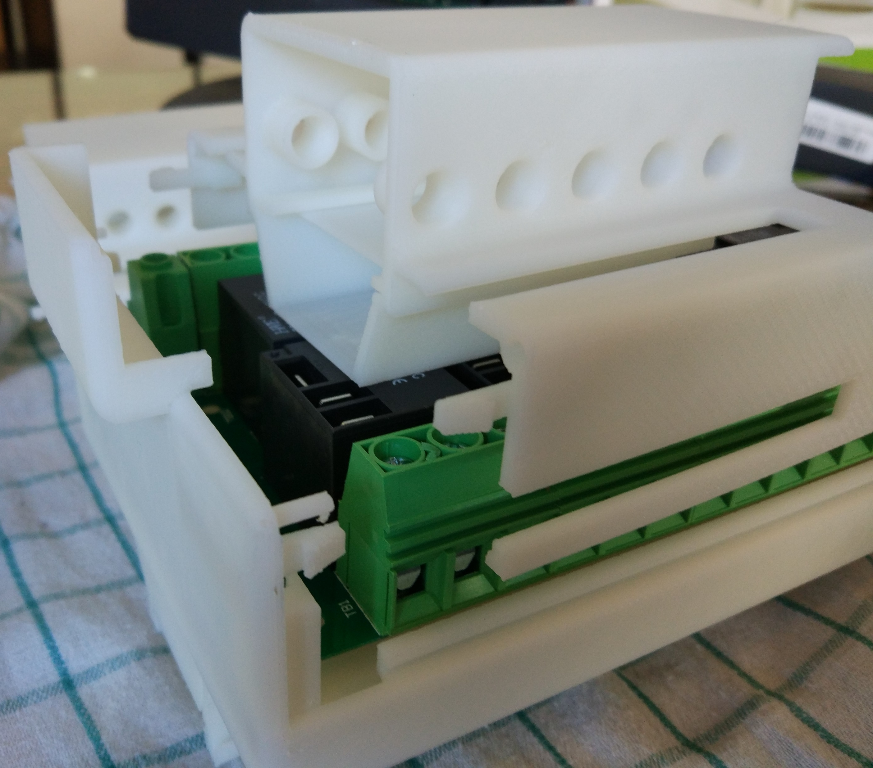
Battery & Zigbee
This doesn’t fit

